Slide 1
Family Economics and Financial Education
Welcome!

Slide 2


THE UNIVERSITY OF ARIZONA
John & Doris Norton School of Family and Consumer Sciences
  Take Charge America Institute for Consumer Financial Education and Research
Notes:
The University of Arizona is FEFE’s home, housed within the College of Agriculture & Life Sciences, in particular the Norton School of Family and Consumer Sciences, see pictures of the new building
FEFE is part of the Take Charge America Institute for Consumer Financial Education and Research, building better lives through financial literacy
Full-time staff able to keep FEFE current so that as changes occur whether it’s suggested educator edits or changes in public policy, FEFE is nimble with a quick turnaround time to post the newly revised materials

Slide 3
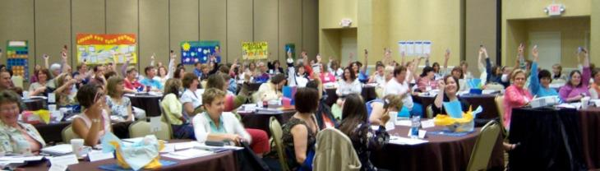

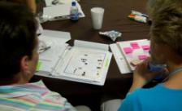

FEFE Mission
“Provide educators with no-cost curriculum materials
and the skills and confidence to effectively
teach family finance”

Slide 4
By Educators…For Educators
It is our DNA!

Slide 5
National Master Educators
Educator Teams
Program
Development
Training
Curriculum
Hallmark of the FEFE Program
10-13 current classroom educators
  Enhanced professional development program component
  Lesson plan development, evaluation and modification
  Guide programming through weekly updates and discussions
Notes:
Reinforce the master teacher program structure is set up to enhance our overall programming quality, future direction, and stay connected to the classroom with the learner in mind
FEFE National Master Educators bring a wealth of accolades, undergo an intensive training process, heavily sought after for media features, winners of many state awards
FEFE’s foundation was built with the primary principle “by educators...for educators” in mind and has continued for nearly a decade. Since FEFE’s inception, the innovative collaboration structure with classroom educators devoted daily to teaching financial education has been central to all operations and new developments
Together as a team of 13, FEFE National Master Educators will have completed 155 evaluations this year alone!

Slide 6
By Educators… For Educators
Goal: Enhance meaningful opportunities for educators to be involved with the FEFE program and receive recognition
National Master Edu.
National trainers
Overall program guidance
State Advocates
Develop state specific resources
Partner with FEFE
TCATS
Volunteer
General feedback
Notes:
Identify that this is a way to also provide better state support without losing our FEFE identity or being constrained by resources when focusing only upon the national master teacher team
It’s a big country and we need more than 12 to be able to tailor our programs to what local educators. National are the ones closest to the fold but their job is not to help us at the state level. Yet we need people out there in states where we have largest presence
Each “team” will be featured in multiple ways on our Web site

Slide 7
New and Updated Resources
Today’s workshop
You should also know…
Savings unit
  100% re-written
Introduction to Investing
  100% new lesson
Credit unit
  100% re-written to reflect the Card Act changes
Identity theft
  100% re-written
Life Cycle of Financial Planning
  Updated to enhance brainstorming and higher quality conclusion and assessment tools
Semester course recommendation
  Has been updated
Test banks
  New questions
Gumball machine
  New lesson for throughout a course
News Interview
  Great new active learning tool to promote critical thinking
Check out the updated resources handout in your folder!

Slide 8
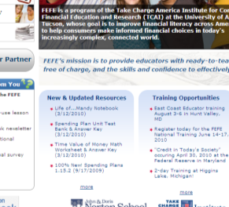
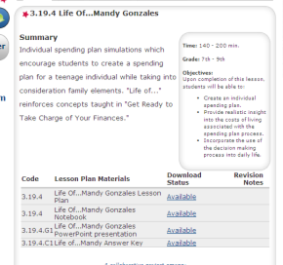

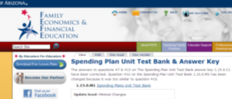
Updated Resources
Home Page
Lesson Plan Page
Personal Download History
Description of Changes

Slide 9
Savings Unit 14.0
* Edited Version

Slide 10
Choosing to Save
1.14.1
Take Charge of Your Finances
*Edited Version
Replaces the Introduction to Saving and Time Value of Money lesson plans

Slide 11
Objectives
Differentiate between saving and investing
Vocabulary Bingo 1.14.1.H1
Saving vs. Investing activity 1.14.1.H2
Interpret the concept of time value of money
Time Value of Math worksheet 1.14.1.A3
Savings Campaign 1.14.1.A4
Analyze opportunity costs of financial goals
Note taking guide (development of a personal savings plan)
Children's books anticipatory set
Rolling Jenga 1.14.1.J1

Slide 12

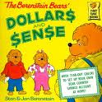

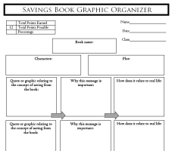
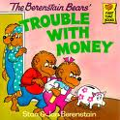
Introduction
Option 1 (30-45 min)
Option 2 (10-15 min)
Break into small groups
Read a children's book
  5 options; each with a different message
Complete the graphic organizer and report to the class
  Make connections between their life and the story
Educator reads Bernstein Bears’ Trouble With Money
Discuss key messages
  Savings habits and setting goals
  Opportunity cost
  Well-being

Slide 13
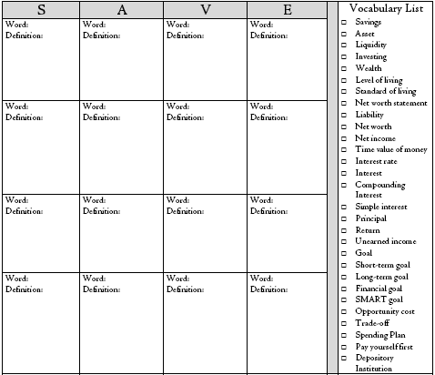
Vocabulary
Bingo Side 1
Identify words you are unfamiliar with
Reference the information sheet to learn the definition
Write the word and its definition (stated in your own words) on a square
Not all words will be used
Word: Savings
Definition: Income not spent on consumption
Playing Bingo is an optional conclusion!

Slide 14
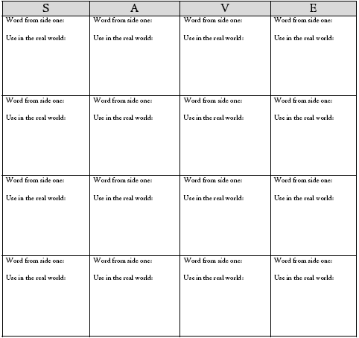
Vocabulary
Bingo Side 2
Optional
Draw pictures or write a sentence using the word
Gather signatures from adults for using the word outside the classroom
Word: Savings
Use in real world:
Small groups are recommended to promote greater comprehension through discussion

Slide 15
My Wish List
Brainstorm a personal wish list for yourself now and in the future.
Throughout the lesson students are creating a personal spending plan to immediately apply the concepts to their lives
My Wish List
Your wish list can include anything of monetary value as well as personal goals.

Slide 16
What does this statement mean to you?
“Today’s self has an impact on future self”
An emphasis is placed upon getting students to consider what they want their financial future to look like!

Slide 17
Time Value of Money
Money paid out or received in the future is not equivalent to money paid out or received today
Three factors affect how an investment will grow.
Interest Rate
Money
Time

Slide 18
How Do Interest Rates Affect Time Value of Money?
Interest rate
More Money
$1,000 invested for 5 years
Interest Rate | Amount Investment is Worth
1% | $1,051.01
3% | $1,159.27
5% | $1,276.28
7% | $1,402.55
9% | $1,538.62

Slide 19
Wish List
Refer to your wish list.
How will you receive these items?
Set Goals!
Goal setting helps you think about your future self.

Slide 20
Opportunity Cost
Opportunity cost of a decision is the value of the next best alternative that must be forgone
Allows you to analyze the consequences of choices to decide which trade-offs to make

Slide 21
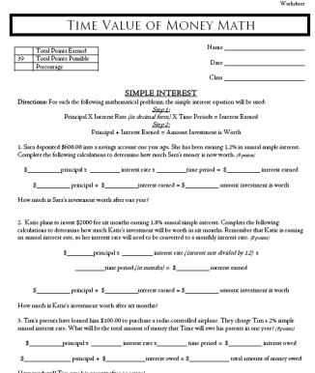
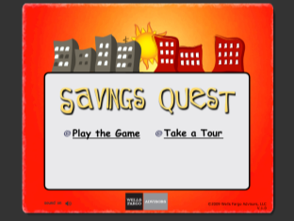
Conclusion options
In addition to Bingo and a traditional review worksheet….
Online game
Sponsored by Wells Fargo
Assessment: Savings Campaign in your community
Math reinforcement worksheet

Slide 22
Rolling Jenga 1.14.1.J1
Set up
Flow of the Activity
Work groups of 5
Select one person to be the “building supervisor”
  Choosing to Save Vocabulary List 1.14.1.E1
Participant: Pull a piece from the within the tower without it tumbling and place it on the top of the tower
Building Supervisor: The building supervisor reads the vocabulary word from their list that matches the number on the tower piece
Participant: Roll the die and complete the assignment for the vocabulary word
  If correct: earn the number of points on the die and it is the next persons turn
  If incorrect: no points are earned and it is the next persons turn

Slide 23
Rolling Jenga 1.14.1.J1
The numbers on the die correspond to the following options:
    Wild: Choose any of the other five dice options
    Definition: Explain the definition of the word.
    Picture: Draw a picture that describes the word.
    Sentence: Use the word in a sentence.
    Importance: Describe why this word is important.
    You: Describe how this word relates to you.
Options are provided to enhance vocabulary comprehension

Slide 24
Teaching Tips
  Use a marker to write numbers on each activity piece, or print off Avery Standard #2181 Mini File Folder labels
  Use a regular die instead of a jenga rolling die
  Provide students with the answer key the first few rounds
  Use play doh to have students “mold” a picture of the word

Slide 25
Any Questions?

Slide 26
Savings Tools1.14.2
Take Charge of Your Finances
*Edited Version
Replaces the Managing Your Cash lesson plan

Slide 27
Objectives
Describe the five savings tools
Start Saving PBS video
Note taking guide
Distinguish characteristics of the savings tools
Four of a Kind activity
Analyze savings tool uses
Characteristics of Savings Tools worksheet 1.14.2.A2
Comparing Savings Tools essay 1.14.2.B2

Slide 28
Facilitation
Create a grid to differentiate between savings tools
Groups present the Savings Tools content
Review-Play 4 of a Kind
Analyze Scenarios
Reflect

Slide 29
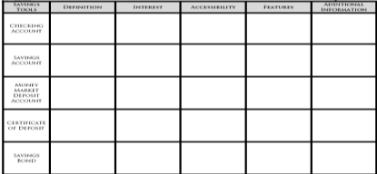
Savings Tools Grid
Each group will receive a deck of Four of a Kind cards, a and a large piece of butcher paper with 6 x 6 grid
Separate the “unlabeled” cards from the deck and set them aside
As a group, spend 2-3 minutes completing the grid based upon what you already know about savings tools
Grid is in Note Taking Guide & answers are in Information Sheet

Slide 30
Content Presentations
Divide participants into five equal groups
  Each group creates a presentation to educate their peers
  A planning guide is included in the note taking guide
  A presentation rubric is available
During the presentation, students complete their note taking guide

Slide 31
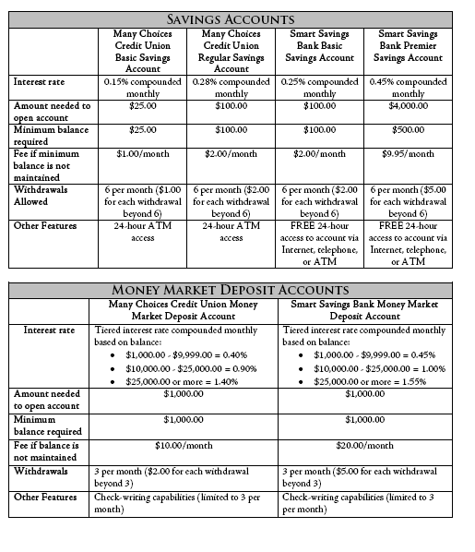
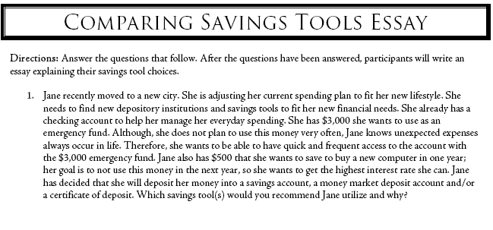
Conclusion/Assessment
Analyze a scenario and determine which savings tool is most appropriate
Account information is provided to assess tools in the context of features and depository institutions!

Slide 32
Savings Tools Scenarios
Mariah has twin daughters who will be graduating from high school in two years. They both have a goal to attend college after graduation, and Mariah wants to help them reach this goal by paying for some of their schooling. She has $2,000 for each daughter that she would like to save and then be able to access in two years. Which savings tool would you recommend Mariah utilize and why?
Scenarios are used to help students think about the situation in which a particular savings tool would be the most appropriate

Slide 33
Any Questions?

Slide 34
Investing Unit
12.0
Replaces the Rule of 72 and Introduction to Investing lesson plans!

Slide 35
Introduction to Investing 1.12.1
Analyze the relationship between risk and return
Describe basic investment tools
Apply the Rule of 72
Interpret the importance of taxation with investing
Anticipatory set
PBS video – Saving for Retirement
Vocabulary Self Awareness Chart 1.12.1.A1
Guest speaker handout 1.12.1.A5
Investing Math 1.12.1.A4
Risk Tolerance Quiz

Slide 36
Financial Risk Pyramid
Financial Security-
Savings Tools
Wealth Accumulation- Investments
Speculation
Increasing potential for higher returns
Increasing risk

Slide 37
Types of Investment Tools
Stocks
Bonds
Mutual Funds
Index Funds
Real Estate
Speculative Investments

Slide 38
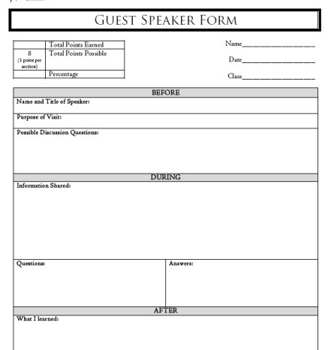
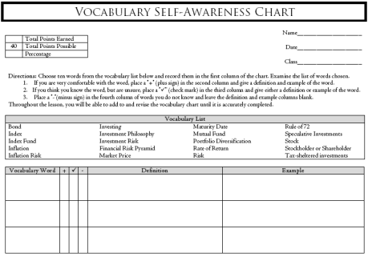
Support Tools

Slide 39
Any Questions?

Slide 40
Credit Unit 4.0
*Edited Version
Updated to reflect The Card Act legislation!

Slide 41
Confessions of a Shopaholic 5.0.44
100% New Lesson Plan!

Slide 42
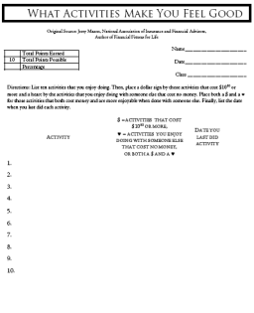
Confessions of a Shopaholic 5.0.44
List ten activities that you enjoy doing.
Place both a $ and a ♥ for those activities that both cost money and are more enjoyable when done with someone else.
Finally, list the date when you last did each activity.
Place a dollar sign ($) by those activities that cost $10.⁰⁰ or more and a heart (♥) by the activities that you enjoy doing with someone else that cost no money.
What Activities Make You Feel Good?

Slide 43
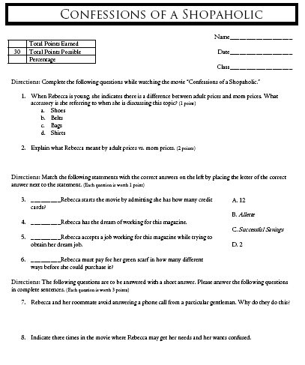
Confessions of a Shopaholic 5.0.44
Confessions of a Shopaholic 5.0.44.A2
Have students complete during the movie
Confessions of a Shopaholic is also a book!

Slide 44


Slide 45
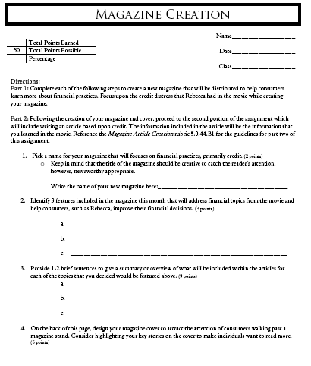
Lesson Plan Assessment
Create a new magazine about financial practices
Design a magazine cover
Write a magazine article
Magazine Article Creation rubric 5.0.44.B1 has guidelines
The assessment is designed to provide students with the “choice” to determine a credit topic of interest to them

Slide 46
Understanding A Credit Card 1.4.1
Take Charge of Your Finances
* Edited Version

Slide 47


Integrating Music
Keep in mind the following questions:
  What do you believe is the overall meaning or purpose of the song?
  What do the lyrics of the song mean to you?
  How do you believe the lyrics relate to our current society?
The song that is going to be played is Ka’-Ching by Shania Twain

Slide 48
Alternative
Anticipatory Set
Participants view a short video clip regarding college student’s knowledge of credit
The class then participates in a full discussion regarding the clip that they viewed and discussion prompting questions provided

Slide 49
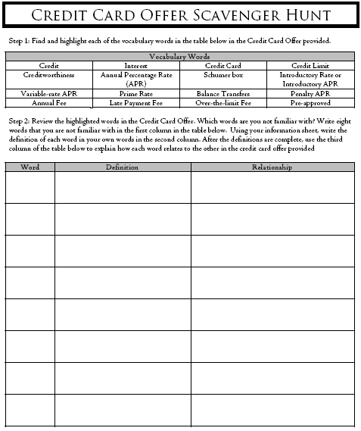
Vocabulary Reinforcement
Step 1: Highlight on the Sample Credit Card Offer (see next slide) each of the vocabulary words
Step 2: Choose 8 of the words highlighted that are unfamiliar and record in the word column
Step 3: Using the Understanding a Credit Card Information Sheet record the definitions for each of the words in the definition column
Step 4: Explain how the words are related to one another and then create a graphic organizer (see next slide)

Slide 50
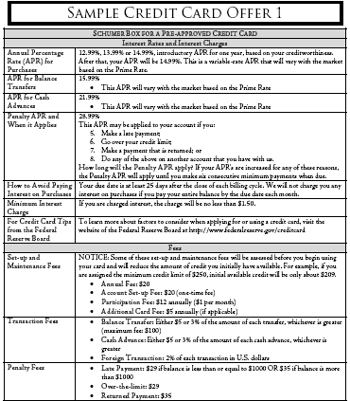
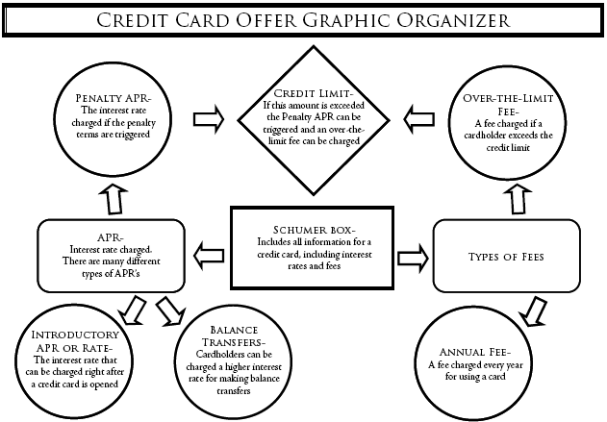
Examples
Sample Credit Card Offer
Example of a Credit Card Graphic Organizer

Slide 51
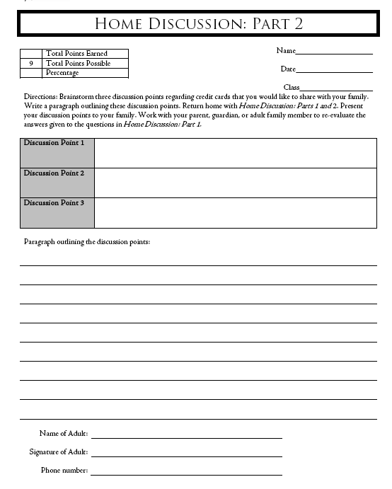
Home Discussion
Before the lesson
  Interview an adult about credit cards
After the lesson
  Identify three discussion points you would have with your family as a result of what you learned in class

Slide 52
Interest Rates and Interest Charges
Annual Percentage Rate (APR) for Purchases | 12.99%, 13.99% or 14.99%, introductory APR for one year, based on your creditworthiness. After that, your APR will be 14.99%. This is a variable-rate APR that will vary with the market based on the Prime Rate.
APR for Balance Transfers | 15.99% This APR will vary with the market based on the Prime Rate
APR for Cash Advances | 21.99% This APR will vary with the market based on the Prime Rate
Penalty APR and When it Applies | 28.99% This APR may be applied to your account if you: Make a late payment; Go over your credit limit; Make a payment that is returned; or Do any of the above on another account that you have with us. How long will the Penalty APR apply? If your APR’s are increased for any of these reasons, the Penalty APR will apply until you make six consecutive minimum payments when due.
How to Avoid Paying Interest on Purchases | Your due date is at least 25 days after the close of each billing cycle. We will not charge you any interest on purchases if you pay your entire balance by the due date each month.
Minimum Interest Charge | If you are charged interest, the charge will be no less than $1.50.
For Credit Card Tips from the Federal Reserve Board | To learn more about factors to consider when applying for or using a credit card, visit the website of the Federal Reserve Board at http://www.federalreserve.gov/creditcard
Fees
Set-up and Maintenance Fees | NOTICE: Some of these set-up and maintenance fees will be assessed before you begin using your card and will reduce the amount of credit you initially have available. For example, if you are assigned the minimum credit limit of $250, initial available credit will be only about $209. Annual Fee: $20 Account Set-up Fee: $20 (one-time fee) Participation Fee: $12 annually ($1 per month) Additional Card Fee: $5 annually (if applicable)
Transaction Fees | Balance Transfer: Either $5 or 3% of the amount of each transfer, whichever is greater (maximum fee: $100) Cash Advance: Either $5 or 3% of the amount of each cash advance, whichever is greater Foreign Transaction: 2% of each transaction in U.S. dollars
Penalty Fees | Late Payment: $29 if balance is less than or equal to $1000 OR $35 if balance is more than $1000 Over-the-limit: $29 Returned Payment: $35
* How We Will Calculate Your Balance: We use a method called “average daily balance (including new purchases).”
* Loss of Introductory APR- We may end your introductory APR and apply the Penalty APR if you become more than 60 days late in paying your bill
Annual Percentage Rate (APR) for Purchases
This section discloses the interest paid for purchases on the card. Multiple interest rates may be listed here, because the final interest rate may depend on the creditworthiness of the applicant
Go to the Federal Reserve Board’s Web site for interactive tools!

Slide 53

Andrew’s Credit Card Statement
Summary of Account Activity
Previous Balance | 535.07
Payments | -450.00
Purchases | +529.57
Balance Transfers | +785.00
Cash Advances | +318.00
Past Due Amount | +0.00
Fees Charged | +69.45
Interest Charged | +10.89
New Balance | $1,784.53
Credit Limit | $2,000.00
Available credit | $215.47
Statement closing date | 3/22/2012
Days in billing cycle | 30
2
Payment Information
New Balance | $1784.53
Minimum Payment Due | $53.00
Payment Due Date | 4/20/12
Late Payment Warning: If we do not receive your minimum payment by the date listed above, you may have to pay a $35 fee and your APR’s may be increased up to the Penalty rate of 28.99%
Minimum Payment Warning: If you make only the minimum payment each period, you will pay more in interest and it will take you longer to pay off your balance. For example…
1
3
4
If you make no additional charges using this card and each month you pay… | You will pay off the balance shown on this statement in about… | And you will end up paying an estimated total of…
Only the minimum payment | 10 years | $3,284
$62 | 3 years | $2,232
Summary of Account Activity
This section includes payments, credits, purchases, balance transfers, cash advances, fees, interest charges, amounts past due, the new balance, available credit, and the last day of the billing period
5
6
Notice of Changes to Your Interest Rates
You have triggered the Penalty APR of 28.99%. This change will impact your account as follows:
Transactions made on or after 4/9/12: As of 5/10/12, the Penalty APR will apply to these transactions. We may keep the APR at this level indefinitely.
Transactions made before 4/9/12: Current rates will continue to apply to these transactions. If you become more than 60 days late on your account, the Penalty APR will apply to hose transactions as well.
Important Changes to Your Account Terms
The following is a summary of changes that are being made to your account terms. For more detailed information, please refer to the booklet enclosed with this statement. These changes will impact your account as follows:
Transactions made on or after 4/9/12: As of 5/10/12, APR for Purchases will increase to 16.99%.
Transactions made before 4/9/12: Current APRs will continue to apply to these transactions.
7
Transactions
Reference Number | Trans Date | Post Date | Description of Transaction or Credit | Amount
XXXX1 | 2/22 | 2/23 | Store #1 | $529.57
XXXX2 | 2/25 | 2/26 | Payment | $450.00 -
XXXX3 | 2/26 | 2/26 | Cash Advance | $318.00
XXXX4 | 3/15 | 3/17 | Balance Transfer | $785.00
Fees
XXXX5 | 2/23 | 2/23 | Late Fee | $35.00
XXXX6 | 2/27 | 2/27 | Balance Transfer Fee | $23.55
XXXX7 | 2/28 | 2/28 | Cash Advance Fee | $10.90
 |  |  | Total Fees for this Period | $69.45
Interest Charged
 |  |  | Interest Charge on Purchases | $6.31
 |  |  | Interest Charge on Cash Advances | $4.58
 |  |  | Total Interest for this Period | $10.89
8
How much did Andrew charge in new purchases during this credit card billing cycle?
2012 Totals Year-to-Date
Total fees charged in 2012 | $90.14
Total interest charged in 2012 | $18.27
9
$529.57
Interest Charge Calculation
Type of Balance | Annual Percentage Rate (APR) | Balance Subject to Interest Rate | Interest Charge
Purchases | 14.99% | $512.14 | $6.31
Cash Advances | 21.99% | $253.50 | $4.58
Balance Transfers | 0.00% | $637.50 | $0.00
10

Slide 54
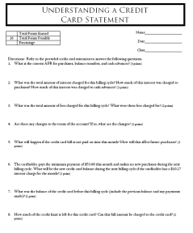
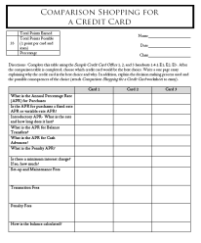
Conclusion/Assessment
Comparison Shopping
Understanding a Statement
Review credit card offers
Determine which one is best
Write a short essay describing why
Evaluate a credit card statement
Reinforce math skills

Slide 55
Understanding Your Credit Card
Credit Cards
101 Trivia
Notes:
55

Slide 56
Credit Cards 101 Trivia
Final Trivia
Terminology | Schumer Box | Credit History | Credit Card Knowledge
$100 | $100 | $100 | $100
$200 | $200 | $200 | $200
$300 | $300 | $300 | $300
$400 | $400 | $400 | $400

Slide 57
Any Questions?
Understanding Credit Reports 1.4.1
Content 100% updated to reflect the implications of the CARD Act for young adults developing a credit history

Slide 58
Identity Theft
1.3.1
100% New FEFE Lesson!

Slide 59
Identity Theft 1.3.1
Assess the dangers
Protecting Your Identity 1.3.1.A1
Note taking guide
Determine what may be done with the information
Watch the FTC video
Identity Theft Education project 1.3.1.B2
Recognize the warning signs of identity theft
Catch Me If You Can 5.0.43
Identity Theft Interview 1.3.1.A2

Slide 60

Solve the Mystery
“Unlucky” Lucy is one of the
many victims of identity theft
What is identity theft?

Slide 61
Solve the Mystery
“Mystery of the Stolen Identity”
Act 2
  Listen carefully and take very accurate notes to help Lucy find the person who stole her identity

Slide 62
How Do They Do It?
The inspector has identified 4 suspects in Lucy’s case.
How does the inspector believe
the suspects stole Lucy’s identity?
  Colonel Mustard
  Searched through Lucy’s outgoing mail
  Mrs. White
  Searched through Lucy’s discarded mail
  Professor Plum
  Searched Lucy’s online banking website
  Mrs. Peacock
  Guessed Lucy’s PIN number

Slide 63
“Solve the Mystery” Activity
Directions
  Divide into 4 groups
  Each group will take turns verbally answering a question about identity theft
  If the question is answered correctly, the group will receive a clue that will help reveal Lucy’s identity thief
  If the question is answered incorrectly, play will move on to the next group and the group that answered incorrectly will not receive a clue
  Play will continue until all 12 clues have been won- each group will have at least 3 chances to receive a clue

Slide 64
Who Did It?
Who is Lucy’s identity thief?
Make your guess!
  Mrs. White
  Searched Lucy’s discarded mail in the kitchen
  Colonel Mustard
  Searched Lucy’s outgoing mail in the conservatory
  Mrs. Peacock
  Guessed Lucy’s PIN number in the hall
  Professor Plum
  Searched Lucy’s online banking website in the library

Slide 65
Any Questions?

Slide 66
Educator Support

Slide 67

FEFE Website
Contact us for support!
You must be logged in to download lesson plans
Every FEFE lesson plan is available for download free of charge!

Slide 68
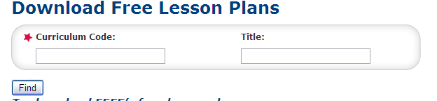
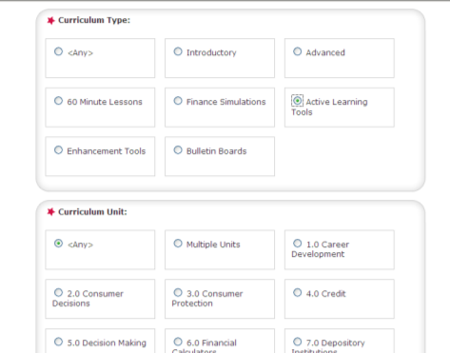
Downloading Lesson Plans
Option 1: Enter the exact code or lesson plan title
Option 2: Enter the curriculum type and unit
Narrow your search as much or as little as desired

Slide 69
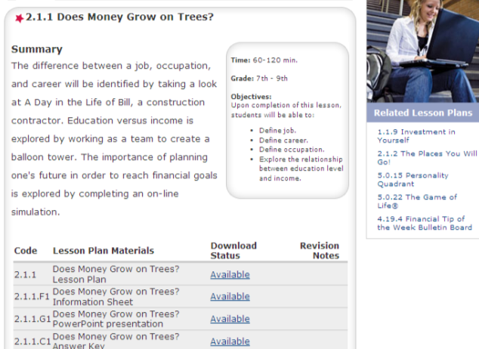
Downloading Lesson Plans
Materials are available as PDF files and PowerPoint
Additional FEFE lesson plans you might be interested in!

Slide 70
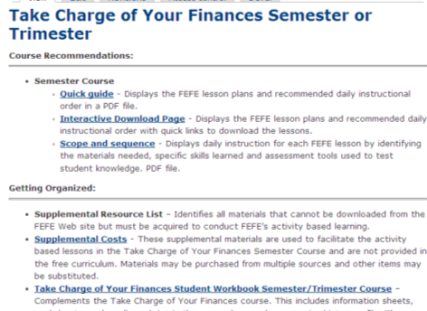
Course support
Course support pages are available
  Course guides
  Activity pieces binders
  Teaching tips
  And more!

Slide 71
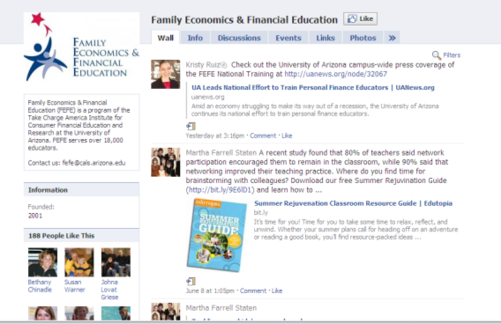
FEFE FaceBook
Ask questions
Network with other educators
Post pictures of student work
Receive FEFE updates

Slide 72

FEFE National Training
June 27-30, 2011
Registration Package - ~$550
Sessions
Breakfast & lunches
Lodging in a shared room
Take Charge of Your Finances binder ($340 value)
Best Practices binder ($50 value)
  Teaching tips and other curricula
FEFE Master Educators
  Demonstrating lesson plans
Keynote sessions
  Card Act
  Credit Scoring
  Young Adults First Encounters with Financial Products
Omni Tucson Resort

Slide 73
Questions?

